Slide 1
Matrix approach to CMIP6 and TRENDY
ISBA (Interaction Soil-Biosphere-Atmosphere)-CTRIP
Assignment week 06-07-2021
MUHAMMAD MOHSIN ABRAR

Slide 2
ISBA-CTRIP
Model Name: (Interaction Soil-Biosphere-Atmosphere)-CTRIP
Lead PI or contact person and her/his affiliation: Christine Delire, CNRM, Centre National de Recherches Météorologiques, UMR3589 Université de Toulouse, 31057, France
Static or dynamic vegetation: Static
Number of plant functional types: 16 plant functional types (9 tree and 1 shrub types, 3 grass types and 3 crop types)
What disturbances are simulated (e.g., land use or fire etc.)?: Fire, Landuse change
Number of pools:16 vegetation types (9 tree and 1 shrub types, 3 grass types and 3 crop types) alongside desert, rocks and permanent snow, The 4 litter and 3 soil carbon pools, and dissolved organic carbon
How are pools connected? See next slides
Outputs for CMIP6:

Slide 3
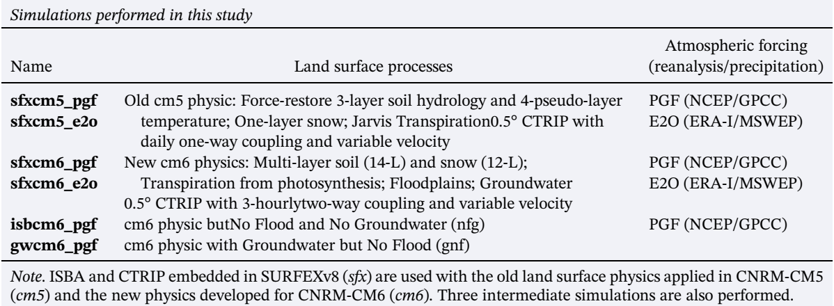
Outputs for CMIP

Slide 4


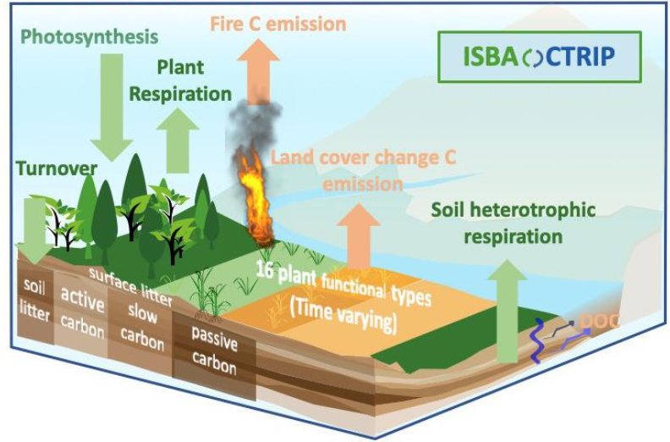

Scheme of the biogeochemical modules in ISBA
CO₂
Photosynthesis
Plant respiration
GPP
Leaf
Stem
Leaves
Turnover
CO₂
CO₂
Soil litter
CO₂
CO₂
CO₂
CO₂
CO₂
Slow carbon
Soil heterorespiration
Active carbon
Passive carbon
Delire et al. 2020
CO₂
Carbon Flow diagram

Slide 5
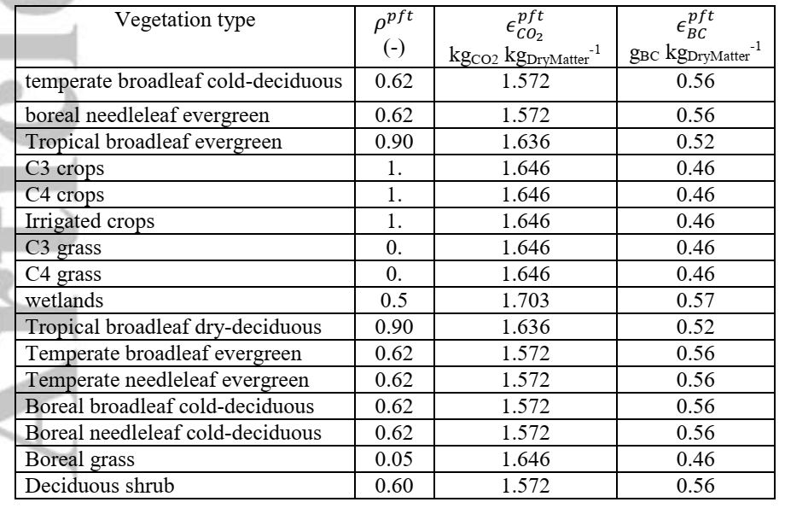
PFT-dependent fire parameters: fire resistance and emissions factors for carbon
dioxide (CO2) and black carbon (BC)
16 plant functional types
Delire et al. 2020

Slide 6
References
Delire, C., Séférian, R., Decharme, B., Alkama, R., Calvet, J., Carrer, D., … Tzanos, D. (2020). The global land carbon cycle simulated with ISBA‐CTRIP: improvements over the last decade. Journal of Advances in Modeling Earth Systems. doi:10.1029/2019ms001886
Decharme, B., Delire, C., Minvielle, M., Colin, J., Vergnes, J., Alias, A., … Voldoire, A. (2019). Recent Changes in the ISBA‐CTRIP Land Surface System for Use in the CNRM‐CM6 Climate Model and in Global Off‐Line Hydrological Applications. Journal of Advances in Modeling Earth Systems. doi:10.1029/2018ms001545

